Slide 1
Gas Scan
Taylor Coomer & Tanner Thurman

Slide 2
Technologies Used
Google Cloud Vision API (OCR)
Firebase (Database tool)
Android Studio

Slide 3
OCR
OCR stands for Optical Character Recognition
Uses the phone’s camera to extract text from pictures
Allows the user to take a picture and extract the relevant text from it and use it for calculations or presentation
In our project, we used Google’s API Google Cloud Vision.

Slide 4
Firebase
Firebase is a Google Database system.
It is free to use up to 100 users.
It allows its users to input data into the database and also comes with multiple APIs for different devices.
Firebase also allows its users to use Google’s Authentication through Google’s Gmail.
In our project, we used multiple Firebase APIs including the Authentication API.

Slide 5
Our Project
This project will provide a useful tool with which users can keep track of their expenditure on fuel, fuel economy, and other related statistics.
The application will utilize Google Cloud Vision services, Firebase database services, and the application will run on Android platforms.
With fuel supplies becoming a more scarce resource, it is important that we keep track of how of this important resource we individually use.

Slide 6
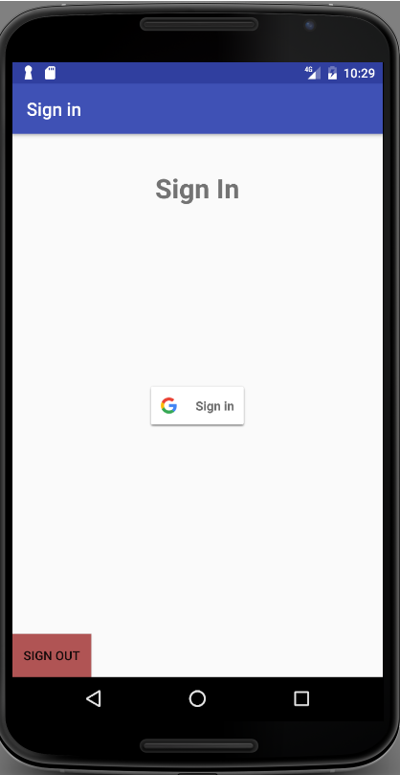
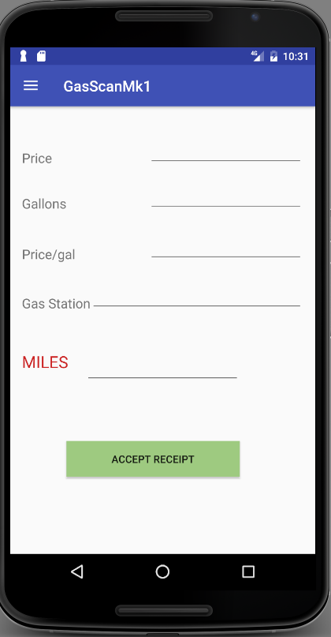
User Interface

